Slide 1
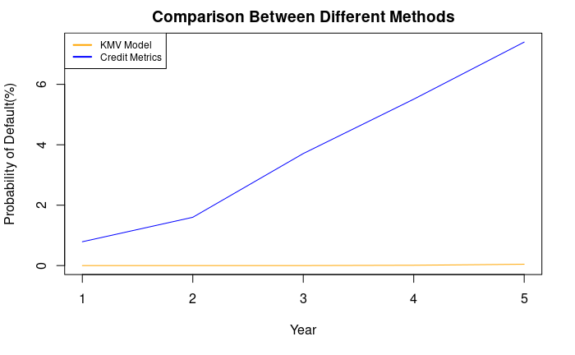
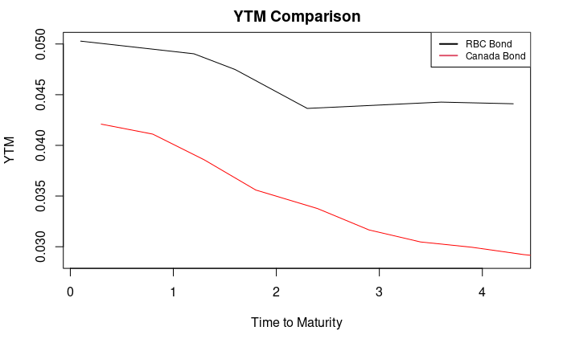
Royal Bank of Canada[RBC]
Credit Risk Analysis
Coupon Rate
RBC Bond
Maturity Date
Bond | Rating
RBC 2.95 May 1 2023 (ISIN: CA780086QC12) | Aa1
RBC 2.35 July 2 2024 (ISIN: CA780086QY32) | A1
RBC 2.61 Nov 1 2024 (ISIN: CA780086RF34) | A1
RBC 4.93 Jul 16 2025 (ISIN: CA780085N938) | Aa1
RBC 5.24 Nov 2 2026 (ISIN: CA780086VV38) | A1
RBC 4.61 Jul 26 2027 (ISIN: CA780086VK72) | A1
Method: Credit Metric
Year | 1 | 2 | 3 | 4 | 5
Probability of Default | 0.79% | 1.60% | 3.71% | 5.51% | 7.40%
RBC Stock
Total Assets | Market Capitalization | Total Debt | Volatility of Stock (risk) | Volatility of Assets (risk)
614.62B | 181.64B | 432.98B | 17.08% | 5.40%
Method: KMV Model
Year | 1 | 2 | 3 | 4 | 5
Probability of Default | 0% | 0.00001% | 0.00112% | 0.01074% | 0.04426%
Data Source: Yahoo Finance (https://ca.finance.yahoo.com/quote/RY.TO?p=RY.TO) / Market Insider (https://markets.businessinsider.com/bonds/finder?borrower=&maturity=midterm&yield=&bondtype=2%2C3%2C4%2C16&coupon=&currency=184&rating=&country=19)

